Slide 1
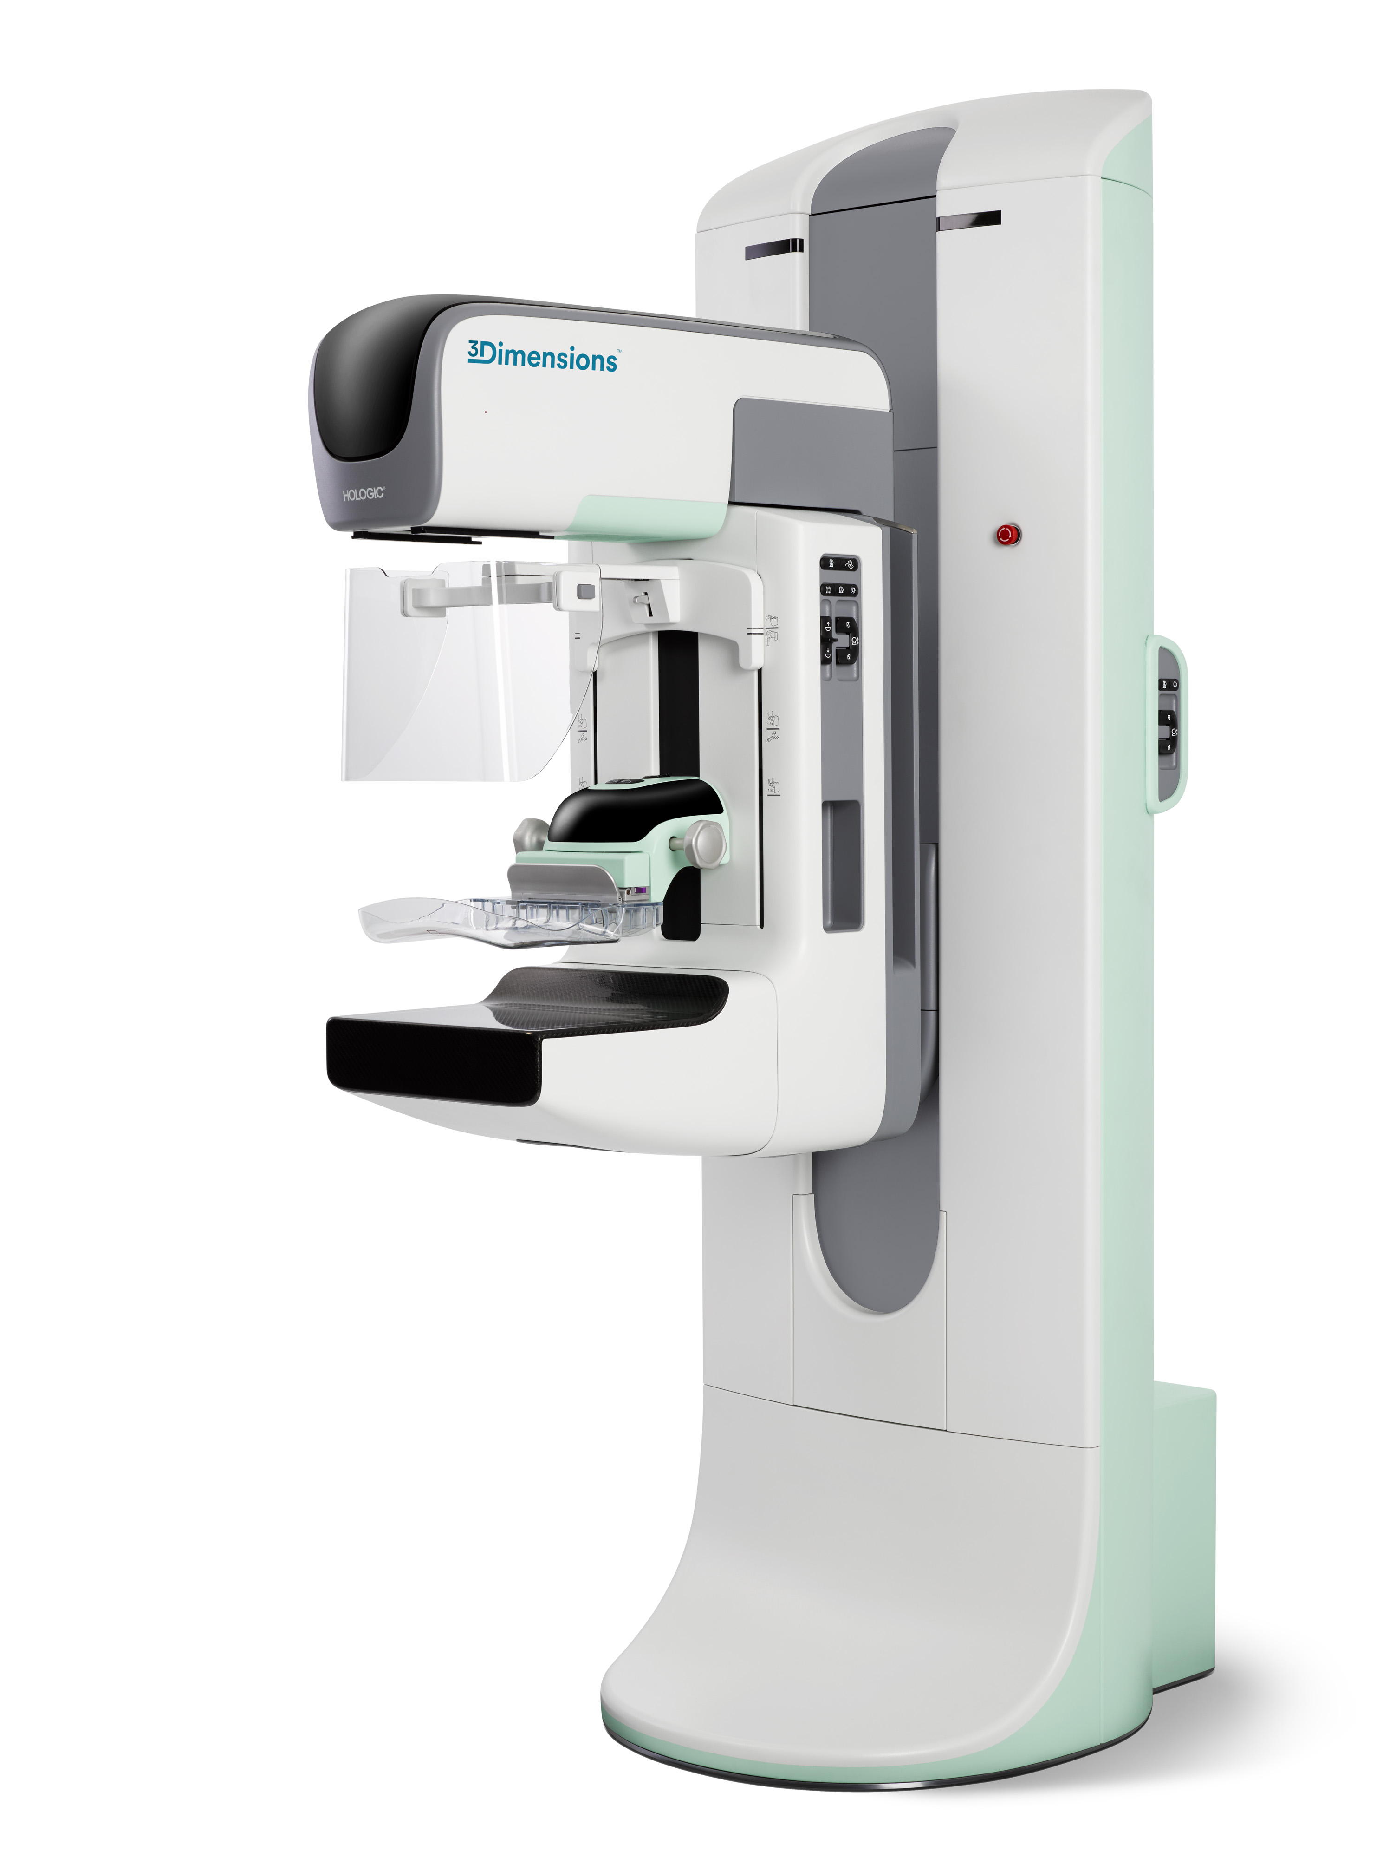
Transitioning to Clarity HD and Intelligent 2D™ Technology

Slide 2
Objectives
Review C-View™ software (synthesized 2D)
Identify next generation tomosynthesis and synthesized 2D imaging
Define technical differences of C-View™ to Intelligent 2D™ software
Recognize image quality improvements with Clarity HD and Intelligent 2D™ software
Compare C-View™ and Intelligent 2D™ images
Recall the importance of digital breast tomosynthesis
Notes:
The agenda is as shown. We will briefly review the importance of digital breast tomosynthesis, the motivation for providing synthesized 2D imaging, and discuss the technical differences between C-View images and Intelligent 2D images. After that, we will show image examples of both versions of synthesized 2D images to illustrate their similarities and differences.

Slide 3
Terminology
2D | FFDM – Full Field Digital Mammography
2D/Tomo | Combo mode procedure where the 2D image is a standard FFDM exposure
3D™ | Hologic’s branded name for breast tomosynthesis
Clarity HD | Hologic’s name for high resolution 70-micron, fast 3.7-second scan time, tomosynthesis imaging
Combo Mode | Procedure where tomo and 2D images are acquired in the same compression
C-View™ software | Hologic’s branded name for the 100-micron synthesized 2D software and images
Intelligent 2D™ software | Hologic’s branded name for the 70-micron resolution synthesized 2D software
SM | Synthesized 2D mammogram, same as Synthesized 2D
Synthesized 2D | 2D image generated from the tomo reconstructed slices, without the need for a 2D exposure May refer to either C-View™ or Intelligent 2D™ algorithms
Tomo | Shorthand for tomosynthesis
TomoHD Mode | Procedure where tomo alone is acquired and synthesized 2D (either C-View™ or Intelligent 2D™) images are generated
Notes:
Throughout this presentation, I will be using these terms/acronyms to represent the Hologic technology.

Slide 4
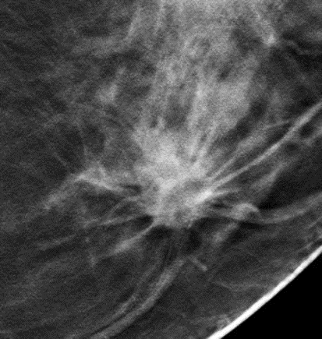
Breast Tomosynthesis: Remarkable Performance
Improves cancer detection AND
Reduces recalls
FFDM
Tomosynthesis Slice
Notes:
I’d like to start by reviewing what is known about the performance of breast tomosynthesis. The use of tomosynthesis in breast cancer screening has been shown to both improve cancer detection while simultaneously reducing recalls of women who do not have breast cancer.

Slide 5
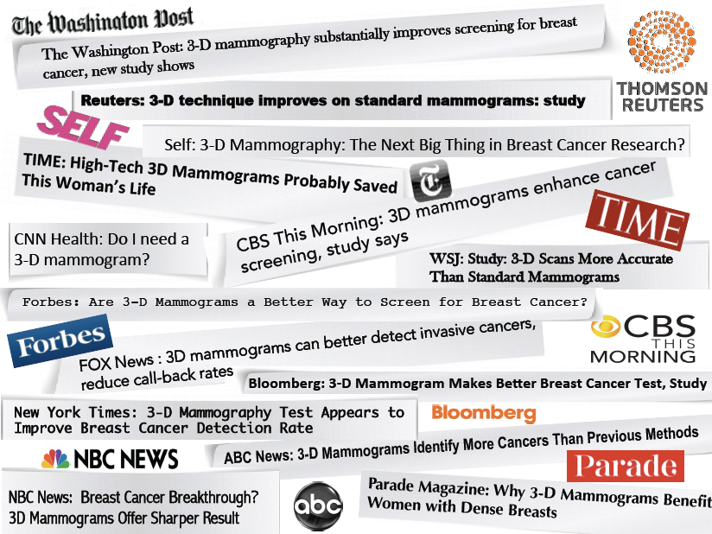
Breast Cancer Screening Using Tomosynthesis in Combination with Digital Mammography - Journal of the American Medical Association (JAMA) 2014
Invasive Cancer Detection Rate
Increased 41% (p <.001)
Recall Rate
Reduced 40% (p<.001)
Friedewald et al. JAMA. 2014;311(24):2499-2507
All studies acquired with Hologic® Selenia® Dimensions® system
Notes:
The large scale clinical trial described in the Friedewald paper showed that tomosynthesis increased the cancer detection rate while decreasing the recall rate, results consistent with earlier smaller studies. This paper reported an increase in detection of invasive cancers of 41% and a reduction in the recall rate of 15%
It is important to note that the study of the performance of breast tomosynthesis in screening involved the use of tomosynthesis in combo mode, where both the 2D and the 3D™ images were available. In particular, the imaging involved acquiring tomosynthesis in both the CC and the MLO projections.

Slide 6
It started with Combo Mode
Tomo scan acquired first
X-ray tube back to center
2D exposure
X-ray tube 15° sweep
Grid retracted
Under a single compression
Single exposure with grid
Notes:
In February 2011, Hologic received FDA approval for first tomosynthesis system.
This tomosynthesis system, the Selenia Dimensions, was able to acquire the conventional 2D FFDM image as well as a tomosynthesis scan with a 2D exposure: Combo Mode.
Acquiring both a Tomo scan and 2D image increases the patient dose, it is still within MQSA limits.
A method for reducing the dose was found with creating a synthesized image with C-View software.
Next slide

Slide 7
Next technology step: low dose imaging software: C-View™ synthesized 2D image
Perform a standard tomosynthesis scan*
3.7 seconds
15 projection images acquired
*Scan time is reduced from ~10 seconds (combo mode) regardless of breast size. A short scan time lessens patient motion risk.
Notes:
The first step to generating a 2D image is to perform the 3D™ scan
Click to display bullet & motion of x-ray tube
The image represents the x-ray tube moving to produce 15 low-dose projection images.

Slide 8
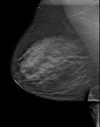
Hologic Synthesized 2D images
Tomosynthesis Slices
Perform a standard tomosynthesis scan
15 projection images are reconstructed into tomosynthesis slices
Tomosynthesis
Reconstruction Algorithm
15 Projection Images
Notes:
After the acquired scan, the projection images will be reconstructed into 1 mm slices. There are an additional 5 slices reconstructed due to paddle tilt.
Click to display up arrow & bullet

Slide 9
Hologic Synthesized 2D Images
Tomosynthesis Slices
Perform a standard tomosynthesis scan
Reconstruct tomosynthesis slices
C-View™ software applied to create Synthesized 2D image
Tomo + synthesized 2D = a low dose examination
Available in any tomosynthesis view
Software
Algorithm
Generated 2D Image
Notes:
From the reconstructed slices, a software algorithm is applied and it creates the synthesized 2D image
Click to display down arrow & bullets

Slide 10
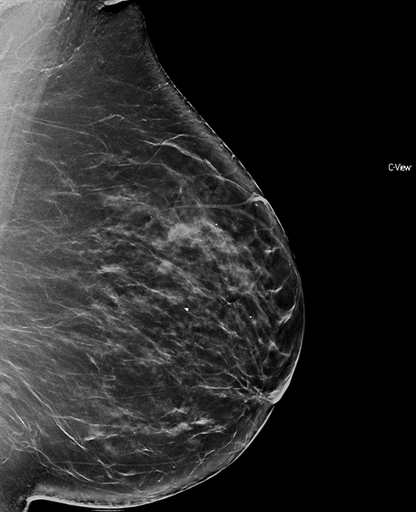
Synthesized 2D Image Usage
Not read alone – always with 3D™ image set
Image is identified as synthesized image – avoids confusion with FFDM image
Intended to be used without the FFDM image
Notes:
The synthesized 2D image replaces the conventional 2D FFDM image.
It is the tomo reconstructed slices that are interpreted; the synthesized image is a ‘road map’ to guide the radiologist through reviewing the tomo slices.
Click x 5 to display text & image

Slide 11
Standard Resolution 3D™ Imaging
100 micron pixel
<5 second reconstruction time
15 degree scan angle
Binning of pixels
3.7 second scan time
C-View™ software – synthesized 2D
Notes:
Our tomosynthesis technology is our standard resolution 3D Imaging and is found on our Selenia Dimensions system. It combines our fast 3.7 second scan time over a 15 degree arc.
15 projection images are acquired and then the reconstructed slices are created. Each reconstructed slice is 1 mm in thickness.
The number of reconstructed slices is based on the compressed breast thickness.
Speed in acquisition as well as reconstruction time is extremely important.
What is Detector Binning and why does Hologic use binning?
Binning is the process of combining data from multiple detector elements into a single image pixel. By this process, reconstructing the tomo data set allow for fast reconstruction time, less than 5 seconds.

Slide 12
The Next Generation
Notes:
Hologic’s next generation of tomosynthesis and synthesized 2D imaging will be discussed next.

Slide 13
Clarity HD with Intelligent 2D™ software
Notes:
The next generation of Hologic tomosynthesis is Clarity HD with Intelligent 2D software.
It is available on the new 3Dimensions mammography system.
Another choice is as a backwards compatible upgrade to your existing Selenia Dimensions mammography system.

Slide 14
Versions of Hologic® Synthesized 2D Images
C-View™ software
First version of synthesized 2D software
100-micron images from 100-micron reconstructions
Both serve the same purpose
Provide 2D image calculated from tomosynthesis dataset
Reduce radiation exposure – eliminates FFDM exposure
Created from standard tomosynthesis dataset
Intelligent 2D™ software
Newest version of synthesized 2D software
Created from high resolution Clarity HD dataset
70-micron images from 70-micron reconstructions
Both used the same way clinically
Notes:
C-View was Hologic’s first version of a synthesized 2D image. It consists of an image of approximately 100 microns resolution, created from tomosynthesis images themselves of resolution approximately 100 microns.
Intelligent 2D is Hologic’s next generation version of synthesized 2D imaging. It is created from a tomosynthesis image set of resolution70 microns and results in a synthesized 2D image of resolution 70 microns.
Both versions of synthesized 2D images serve the same purpose – to replace the 2D FFDM image in a screening examination and both reduce radiation exposure by the elimination of the FFDM image.
Both have the same indications for use.
Left click x 7

Slide 15
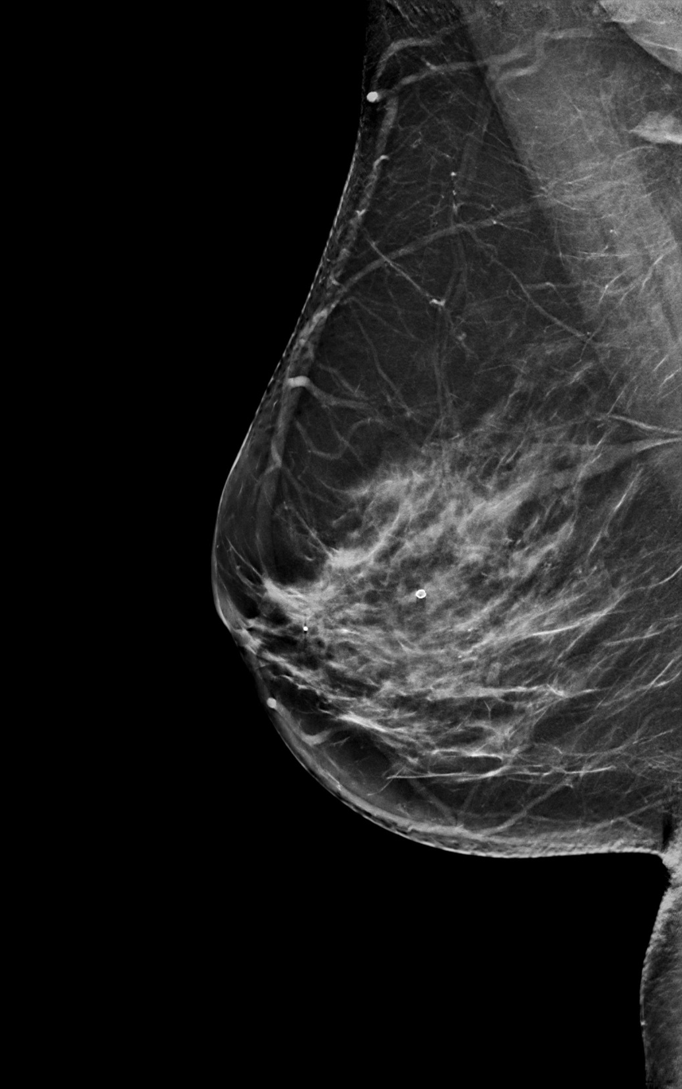
Identifying the Intelligent 2D™ Image
Intelligent 2D™ software marks the image similarly to C-View™ software
Notes:
An Intelligent 2D image is clearly marked on the image, to distinguish it from a 2D FFDM image.

Slide 16
High Resolution 3D™ Imaging
Clarity HD
Detector: 70 micron pixel – same as 2D acquired images
Display: 70 micron
Same reconstruction method as standard resolution
Filtered back projection with iterative contrast adjustment
Notes:
Clarity HD is Hologic’s High Resolution imaging.
It is a new detector that acquires the tomo scan with 70 micron pixels and then displays the reconstructed images in 70 micron.
The same reconstruction software as the previous generation standard resolution is utilized.
And it uses the Filtered back projection with iterative contrast adjustment.

Slide 17
Comparison
High Resolution 3D™ Imaging
70 micron pixel
Standard Resolution 3D™ Imaging
100 micron pixel
No Binning
15 degree scan angle
3.7 second scan time
Intelligent 2D™ software
<5 second reconstruction time
Binning of pixels
15 degree scan angle
3.7 second scan time
C-View™ software
<5 second reconstruction time
Notes:
The comparison chart will help you understand the differences between the two technologies.
Pixels sizes have changed and it is no longer necessary to bin pixels.
But several areas remain the same:
15 degree scan angle
Speed of acquisition
Reconstruction time
Both have the ability to create a synthesized 2D image

Slide 18
Clarity HD – Intelligent 2D™ Resolution
Algorithm improved over C-View™ algorithm
Starts with higher resolution tomo slices
Microcalcification visibility improved
More natural look like 2D
Skin line
De-metal
Identification/ enhancement of suspicious features
Extensive CAD-like algorithms & database
Additional changes
Machine learning/artificial intelligence
Used in our SmartMapping feature
Notes:
Let’s review a few more details:
Intelligent2D = 70 microns, same as 2D – 2D FFDM images are acquired with a 70 micron pixel
Standard resolution C-View ~ 100 microns
Clarity HD algorithm improved over C-View
Starts with higher resolution tomo slices
Microcalcification visibility improved. True positives. False positives.
Other changes made in addition to the resolution improvement
More natural look like 2D
Skin line
De-metal
Identification and enhancement of suspicious features to highlight in the synthesized image
Machine learning/artificial intelligence ‘under the hood’
Relies on Hologic’s extensive knowledge of CAD-like algorithms, and database to test
Used in our SmartMapping feature

Slide 19
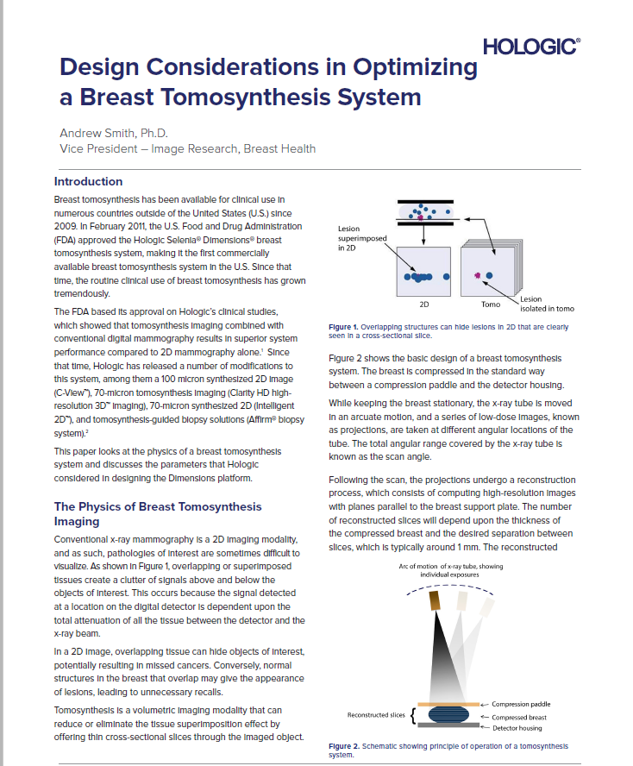
Notes:
There is a current white paper that explains the physics of a breast tomosynthesis system and discusses the parameters that Hologic considered in designing the Dimensions platform.
It is written by Dr. Andrew Smith, vice president, Image research, breast health for Hologic.

Slide 20
Clarity HD Technology on 3Dimensions™ Mammography System
New system
Hardware
Detector
Grid
Gantry
Software
Intelligent 2D™
Notes:
Linear grid
Improve overall system reliability.
Technology advances and the quality advances, post-processing can do a lot!
Today the grid is only used for 2D imaging. We’re at the start of the 3D imaging standards now.
A linear grid can provide equivalent quality and is designed to have equivalent or non-inferior reliability
Gantry
Side buttons
The buttons provide an easy access for everyone (Short/tall) at the gantry side.
Same functions as we know from the buttons on the C-arm side to control the C-arm (does not include paddle controls).
Biggest ergonomic improvement.

Slide 21
Clarity HD Technology on Selenia™ Dimensions™ Mammography System
Requires:
Software upgraded
New detector
New linear grid
New computer
Notes:
Clarity HD – on the Selenia Dimensions Mammography system
Requires: New detector - New linear grid - New computer
The software is upgraded as well
New, improved tomosynthesis
Superior resolution
Matches resolution of FFDM
Utilizes the 70 micron pixel
Tomo scan acquired in 70 micron
Raw projection data maintains high resolution
A higher resolution is increased in the primary tomo images
Scan time, <4 seconds, is still maintained
Major improvement is seen in the Intelligent 2D images (synthesized)
Synthesized images ‘look’ more like FFDM
Reduction in noise, contrast appearance of C-View image
Images are 70 micron
Visibility of calcifications improved

Slide 22
Intelligent 2D™ software
Overall Image Quality
Superior resolution (70m)
Reduced image noise and blur
Skin line sharper and more clear
Improved overall contrast
Artifacts from bright objects (clips, large calcifications) are reduced
Lesion Visibility
Mass margins are sharper
Spiculations for subtle distortions may be enhanced
Improved visibility of small micro-calcifications

Slide 23
Overall Image Quality: Superior resolution
Image resolution of Hologic’s 2D images
Image Type | Image Resolution (in µ)
Conventional FFDM | 70
C-View™ image | ~100
Intelligent 2D™ image | 70
Notes:
The first approved version of Hologic’s synthesized 2D image, known as C-View, is generated at approximately 100 microns. This resolution is lower than Hologic’s 70-micron FFDM images. The Intelligent 2D image has a higher resolution of 70µ which is equivalent to the conventional FFDM images.

Slide 24
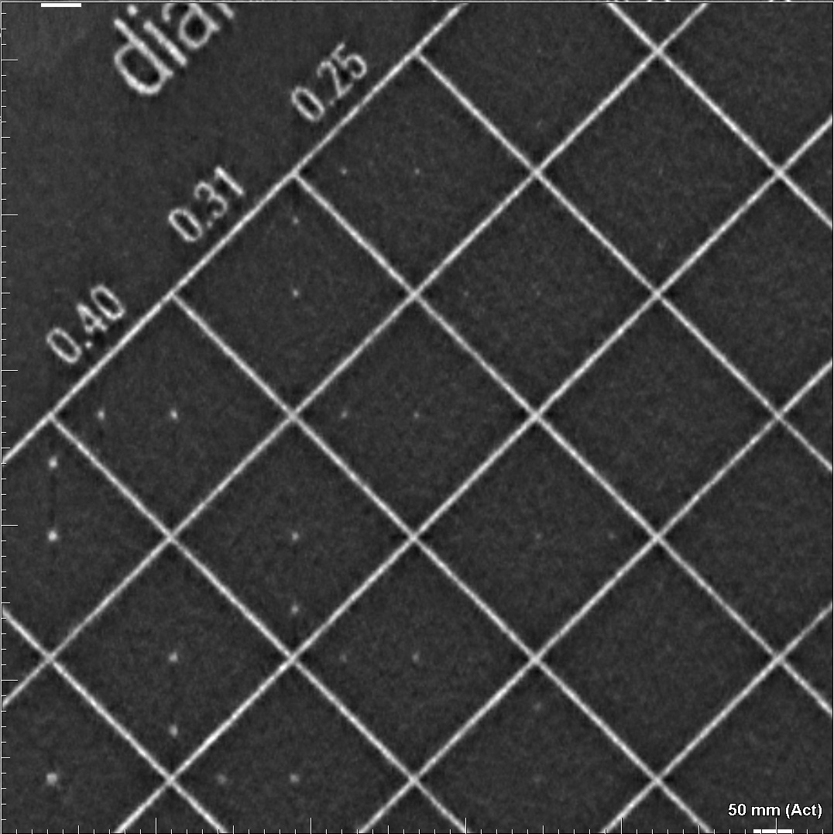
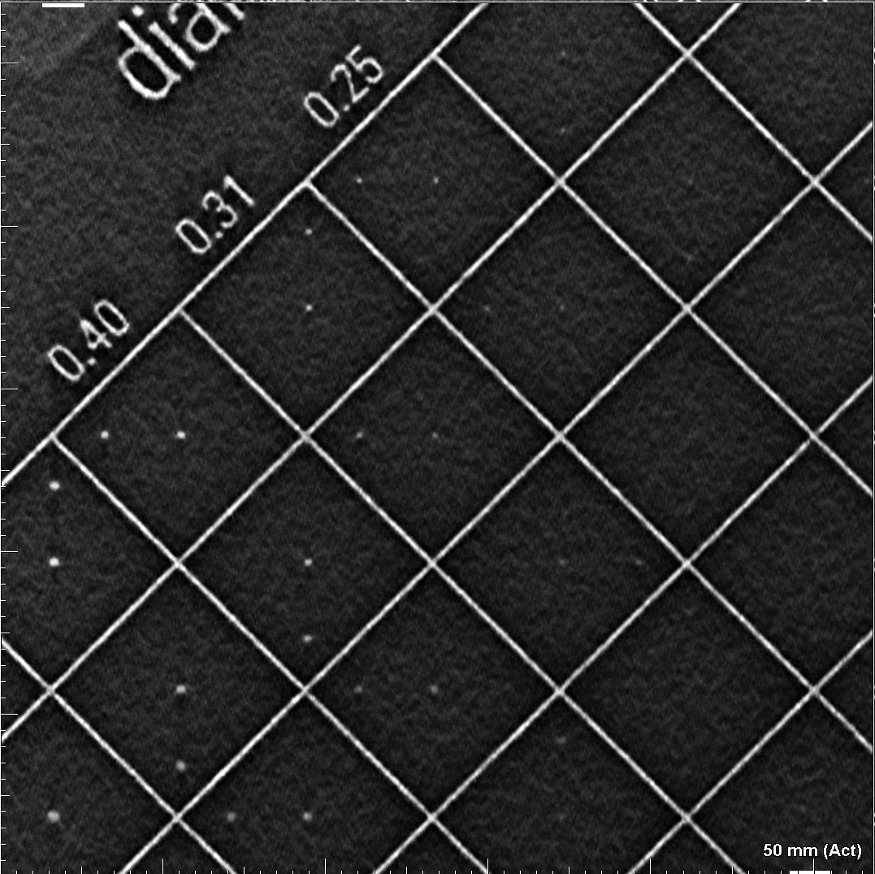
Overall Image Quality: Superior Resolution
C-View™ software
Intelligent 2D™ software
Notes:
This slide shows synthesized 2D images acquired using a contrast-detail phantom. On the left shows the zoomed version of the C-View image and on the right shows the same region on Intelligent 2D image. The outline of the small dots is much better appreciated on Intelligent 2D image due to enhanced resolution of the image.

Slide 25
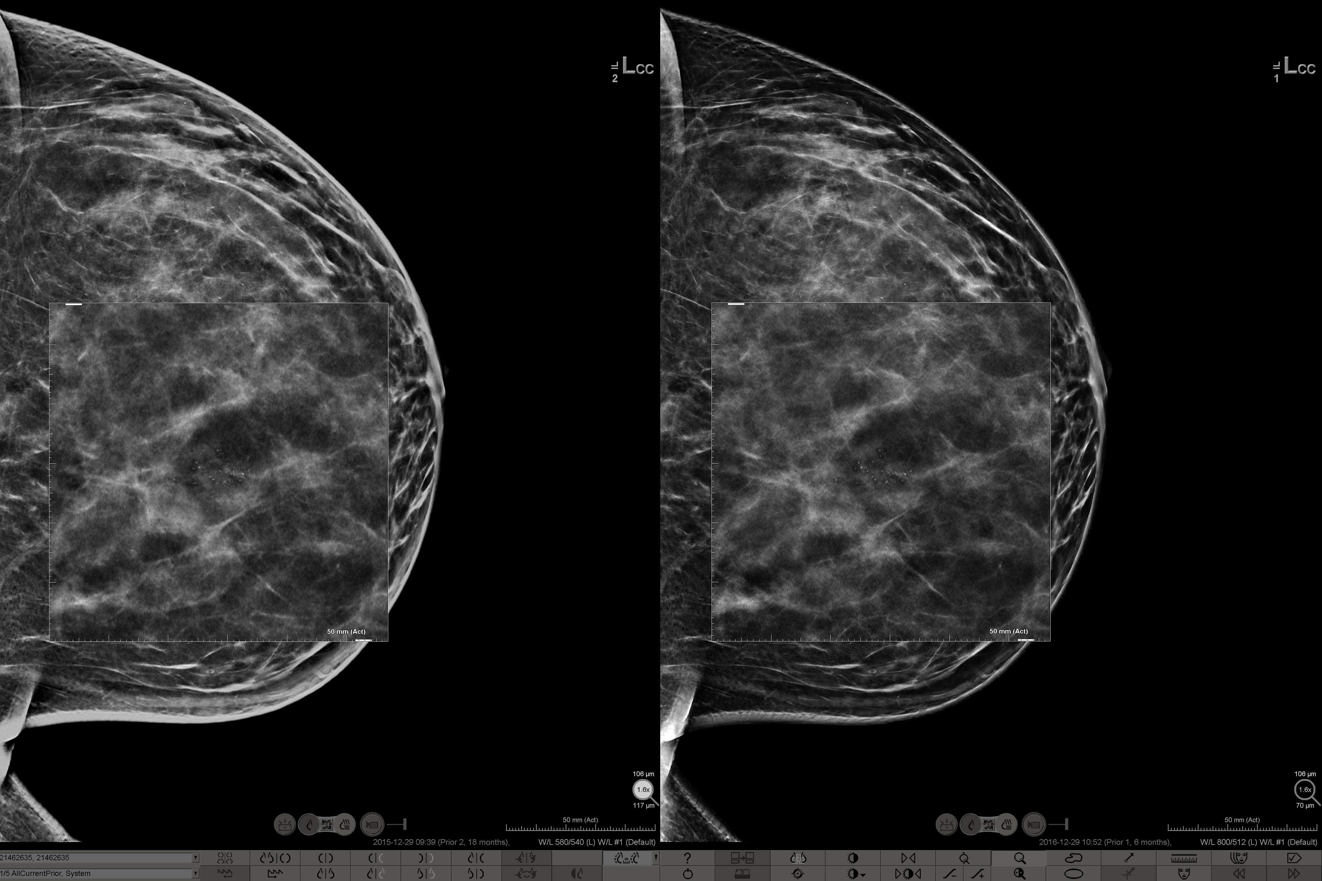
Overall Image Quality: Superior Resolution
C-View™ software
Intelligent 2D™ software
Notes:
Higher resolution of Intelligent 2D enables better visualization of small structures such as the morphology of calcifications. This slide shows a cluster of tiny calcifications on C-View (on the left) and Intelligent 2D (on the right). They are shown magnified on the following slide.

Slide 26
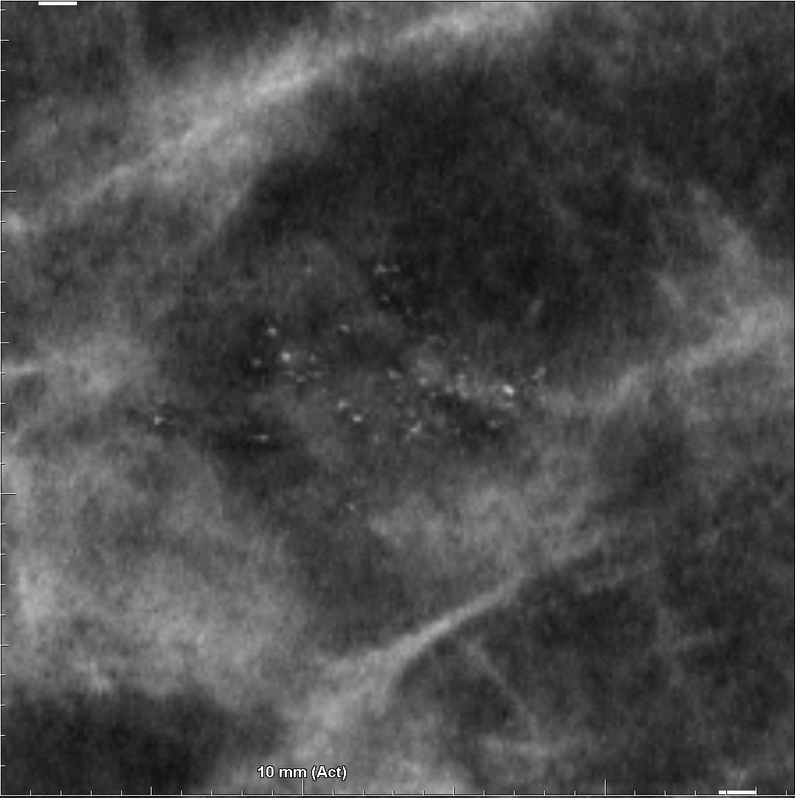
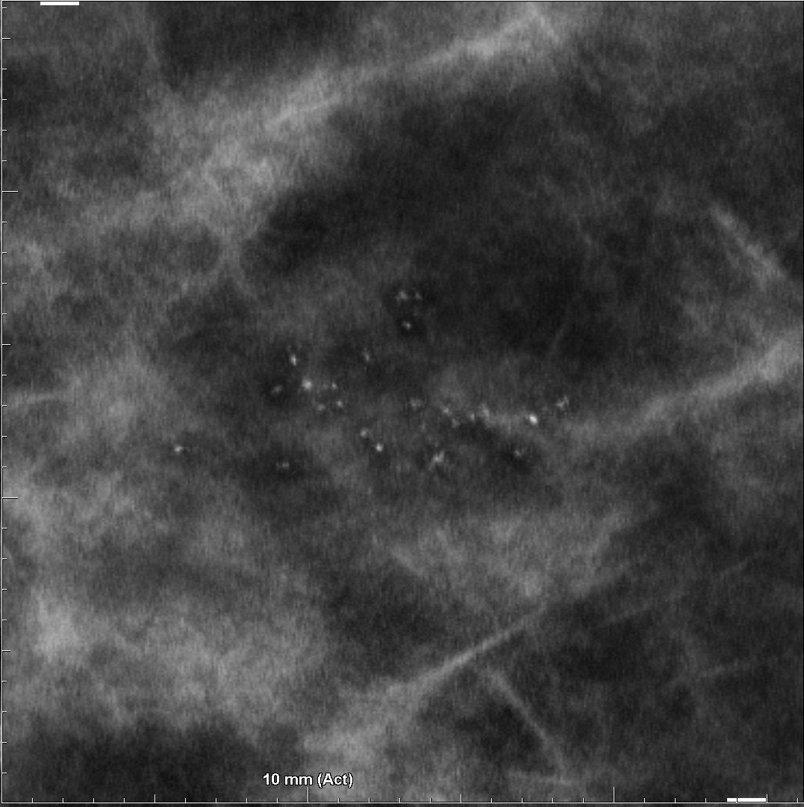
Overall Image Quality: Superior Resolution
C-View™ software
Intelligent 2D™ software
Notes:
This slide shows the a cluster of calcifications in a zoomed version of region of interest. Once again, C-View is displayed on the left and Intelligent-2D on the right. Intelligent 2D being a relatively higher resolution image, the shape of calcifications is better appreciated in this image. Certain types of faint amorphous clusters which were challenged by resolution of C-View are expected to be visualized better with Intelligent-2D image.

Slide 27
Overall image quality: Reduced noise and blur
Intelligent 2D™ software is designed to:
Reduce background noise without losing clinically important high frequency information
Reduce image blur with image processing techniques (side-effect of tomosynthesis reconstruction algorithm followed by synthesis of a 2D image)
Notes:
Now we will review two specific enhancements designed in Intelligent-2D images over C-View images, namely, lower background noise and reduced blur. An advanced “de-noise” technique has been used to achieve reduction in background noise without losing clinically important high frequency information in the images. In addition, image blur, which is a result of tomo reconstruction and algorithm for generation of synthesized 2D is reduced by using image processing techniques utilized in generation of Intelligent 2D images. As a result, the design of the Intelligent 2D image is expected to be easier on reader’s eyes.

Slide 28
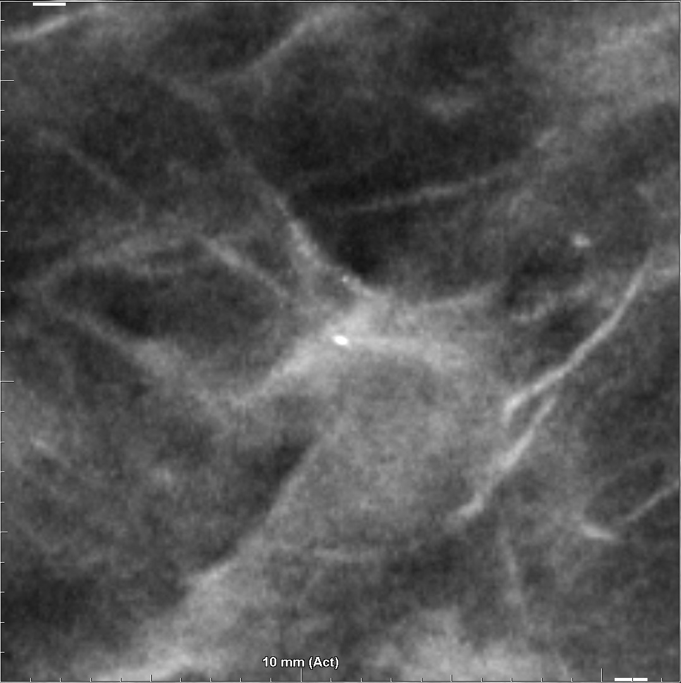
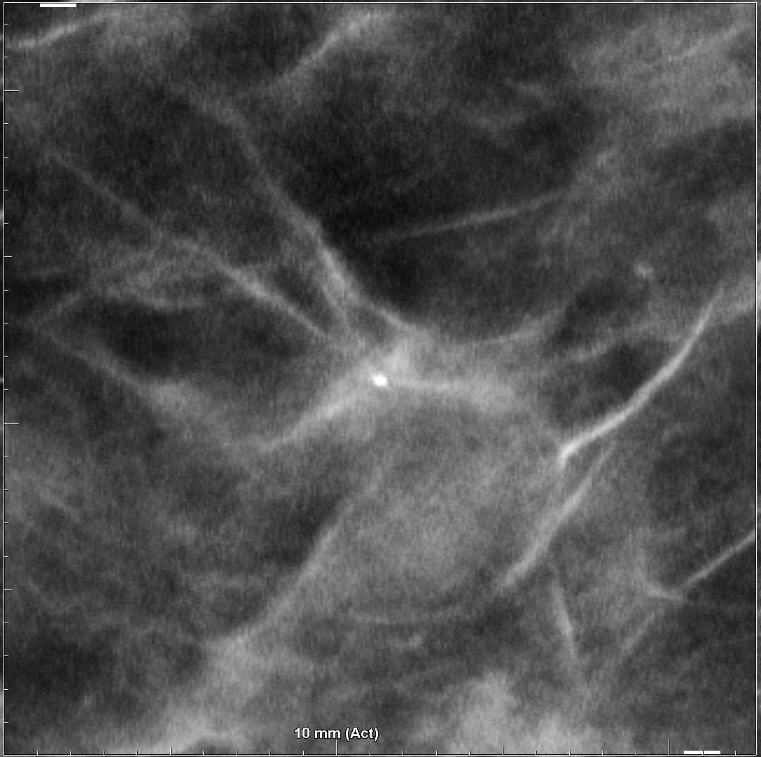
Overall Image Quality: Reduced Image Noise
C-View™ software
Intelligent 2D™ software
Notes:
This slide illustrates advantages on reduced noise in Intelligent-2D images particularly with respect to appearance of over-enhanced normal tissue structures mimicking presence of calcifications. On the left is a zoomed version of C-View image which shows a true calcification indicated by green arrow and a region of over-enhanced noise that may appear like calcifications shown by yellow arrows. The picture on the right shows the exact same region indicated in Intelligent-2D image. The overall reduction in noise resulted in elimination of appearance of over-enhancement.

Slide 29
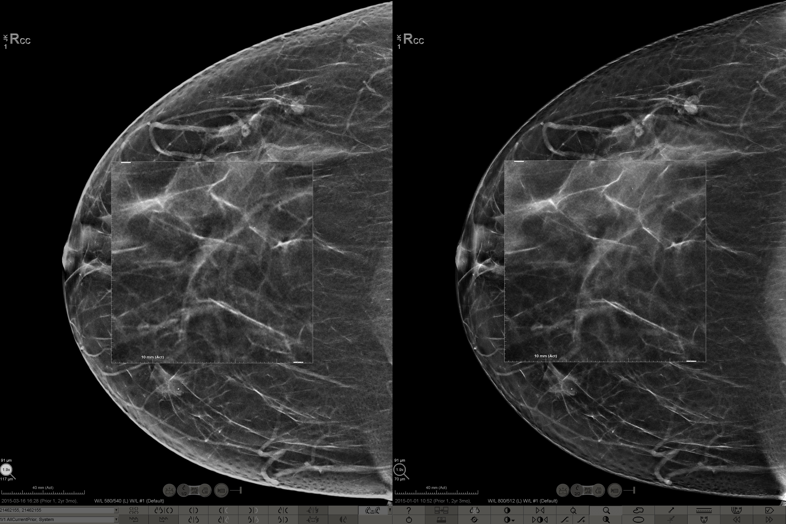
Overall Image Quality: Reduced Image Blur
C-View™ software
Intelligent 2D™ software
Notes:
This slides shows an example of a busy breast tissue with several linear tissue strands. On the left is C-View image and on the right is the Intelligent 2D image of the same breast. Now let’s zoom further to appreciate the differences in these two versions of synthesized-2D images.

Slide 30
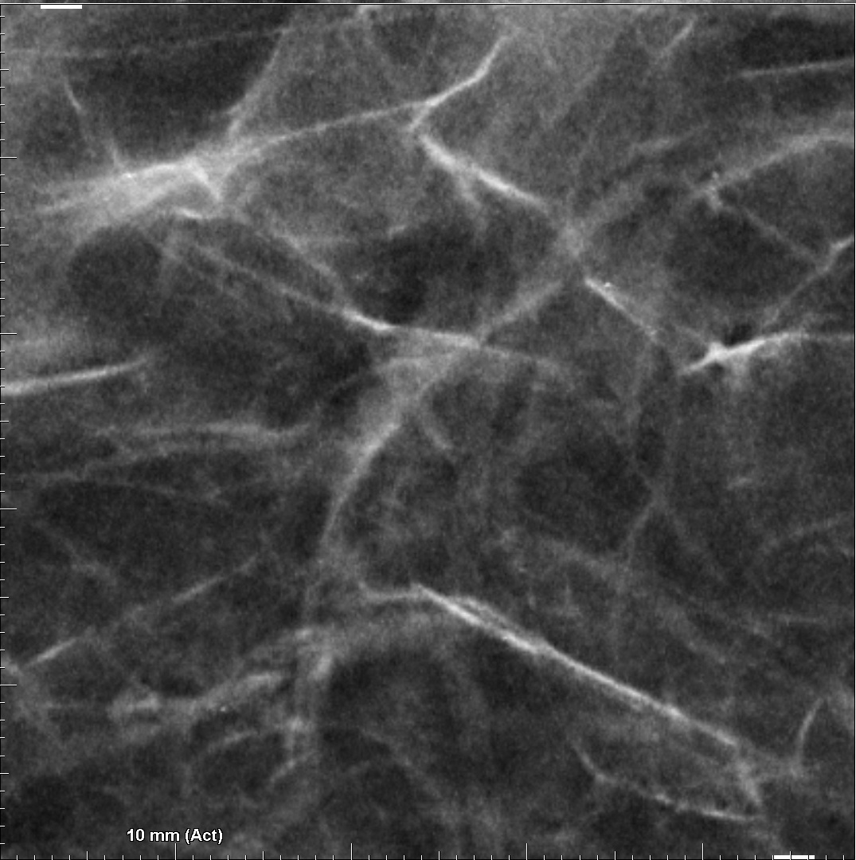
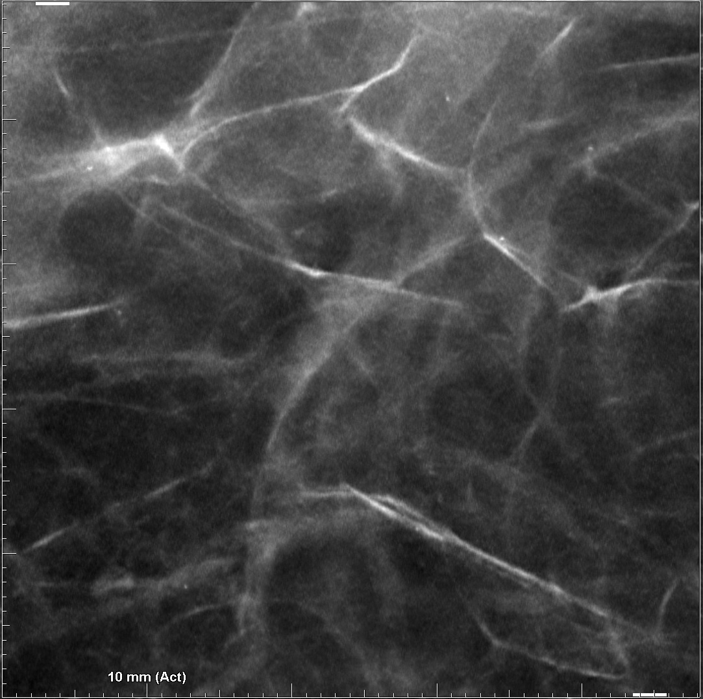
Overall Image Quality: Reduced Image Blur
C-View™ software
Intelligent 2D™ software
Notes:
In this slides, compared to the C-View image on the left, the parenchymal tissue strands in the Intelligent 2D image on the right look sharper and more continuous. The effect of noise, blur and discontinuities in tissue structure are diminished in Intelligent 2D images making it easier to review and search for small abnormalities.

Slide 31
Overall Image Quality: Skin-line and contrast
Intelligent 2D™ software is designed to:
Enhance the skin-line appearance
Improve overall image contrast
Creates an image similar to conventional FFDM images
Notes:
Next we will review two more improvements presented in Intelligent-2D images compared to C-View images, namely, improved appearance of skin-line region and enhanced overall contrast.
Intelligent 2D image will have better appearance of skin-line and breast roll-off region.
In addition, overall image contrast will be enhanced by novel techniques of analyzing pixel value distributions in breasts of different parenchymal compositions.
Enhancements in skin-line appearance and overall image contrast leads to a more natural looking Intelligent 2D image.
As a result, the intelligent 2D image looks similar to conventional FFDM image. Let’s review examples of images illustrating these improvements.

Slide 32
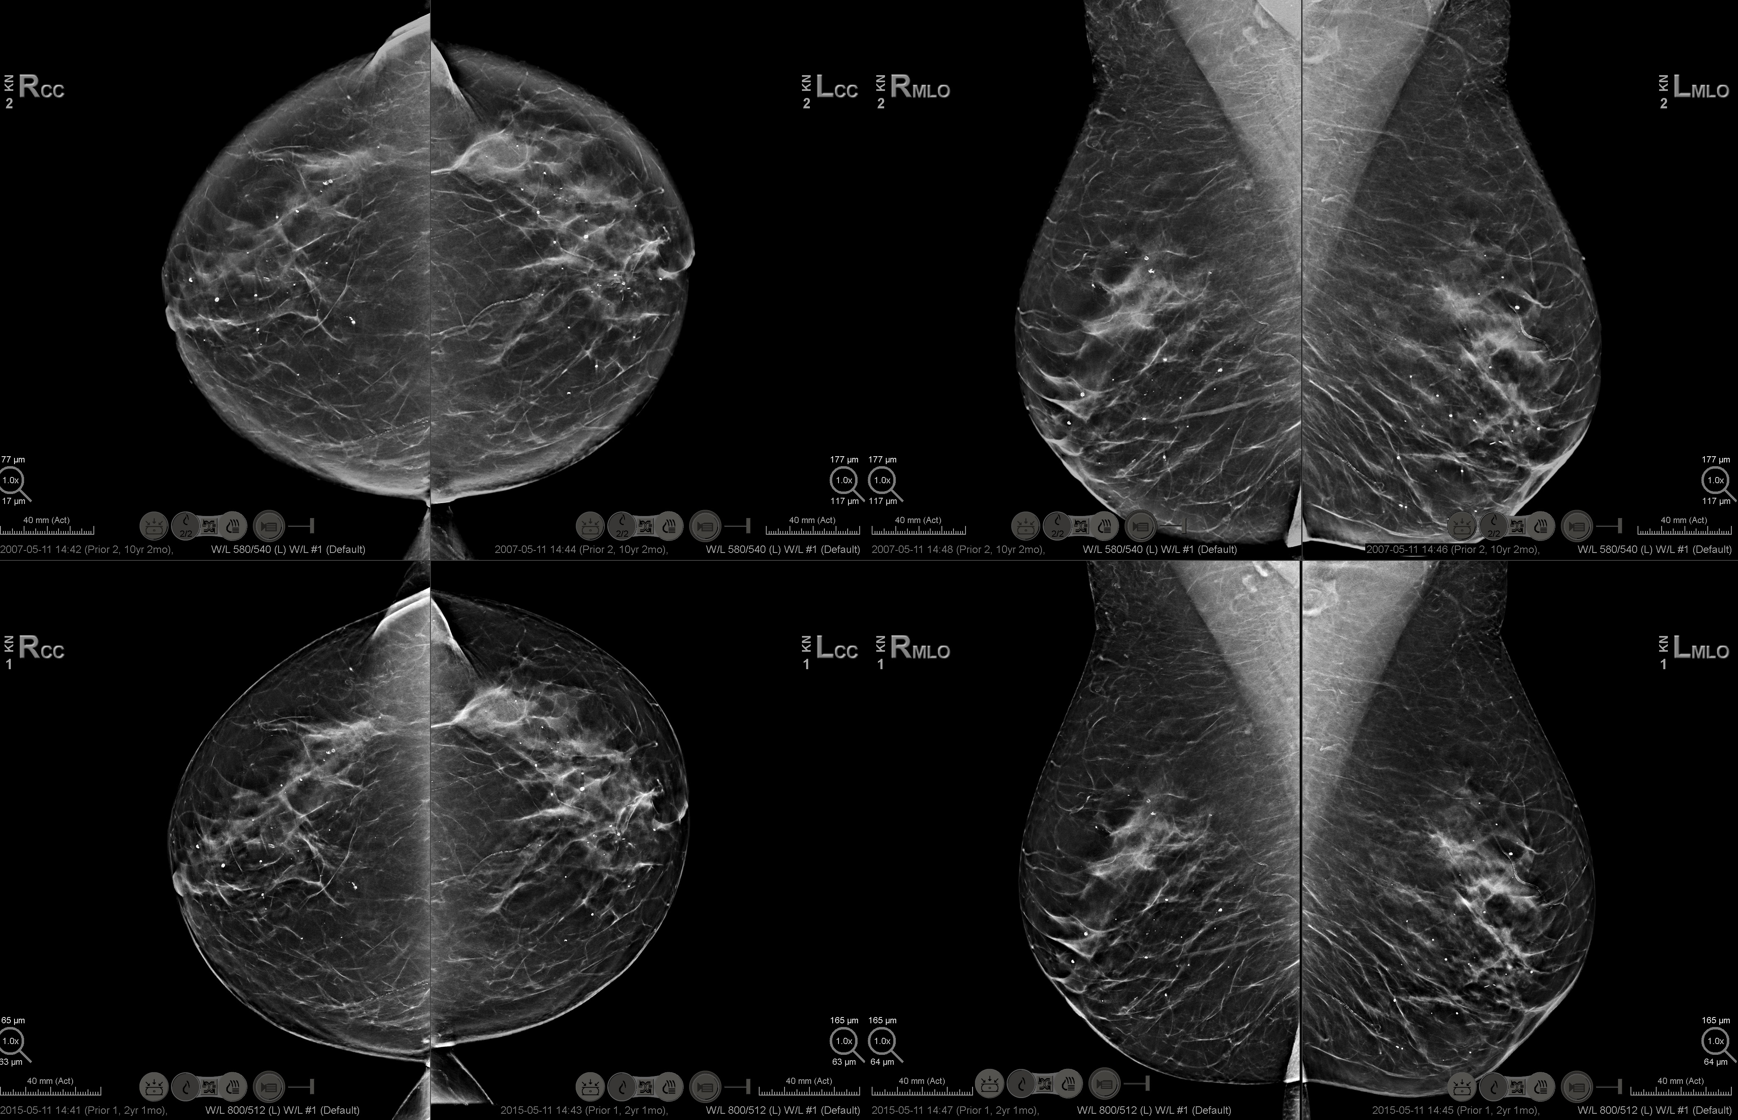
Overall Image Quality: Skin-line and Contrast
C-View™ software
Intelligent 2D™ software
Notes:
This slide shows a standard 4-view tomosynthesis study with C-View images displayed on the top and the Intelligent 2D images from the same patient at the bottom.
Intelligent 2D images in this example illustrate improvements in appearance of skin-line as well as breast roll-off region.
In addition, overall image contrast is enhanced in intelligent 2D images when compared with their C-View counterparts.
Lets focus on smaller regions from images in this study to better understand these enhancements.

Slide 33
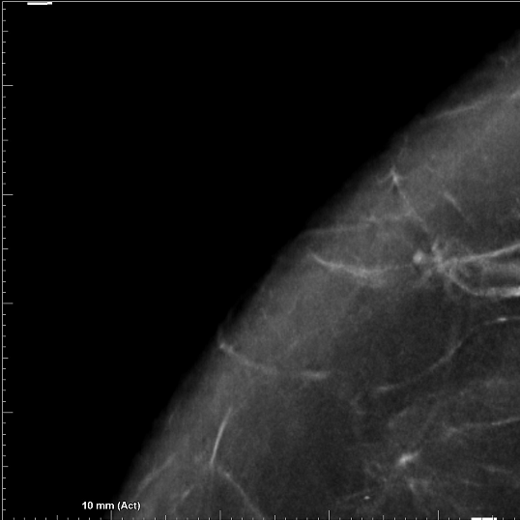
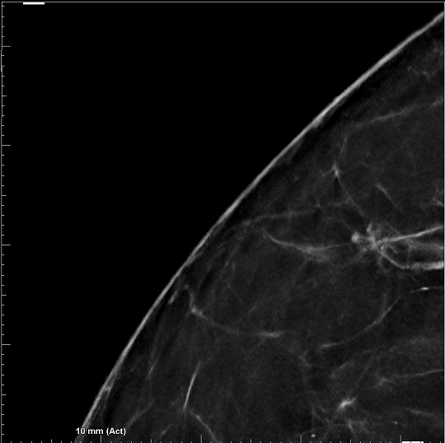
Overall Image Quality: Skin-line Improvement
C-View™ software
Intelligent 2D™ software
Notes:
This slide shows an enlarged view to compare appearance of skin-line on one view in the same study. As indicated by the yellow arrow, C-View image occasionally contained a brighter band of pixel values that appeared on the image in the region of roll off of the breast. On the Intelligent 2D image this region shows a natural looking skin roll off. In addition, as noted by the green arrow, the skinline which was occasionally ambiguous on C-View, is well-delineated on Intelligent 2D images

Slide 34
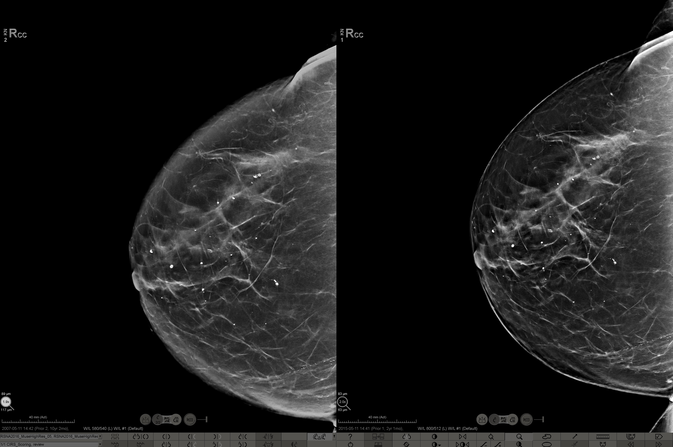
Overall Image Quality: Contrast Enhancement
C-View™ software
Intelligent 2D™ software
Notes:
This picture illustrates the differences in the overall contrast of the right CC view of the same study with left image showing C-View image and right image showing the Intelligent 2D image.
The Intelligent 2D image shows increased contrast when compared with C-View image.
The background fat appears darker in Intelligent 2D image and the denser tissue stands out better when compared to C-View image.
As a result of improvements in skin-line region as well as overall contrast, Intelligent 2D image looks more like conventional FFDM image.

Slide 35
Overall image quality: Reduction in artifacts
Intelligent 2D™ software is designed to:
Decrease image artifacts around large calcifications and metal objects
Synthesized 2D image inherits certain image artifacts from the tomosynthesis limited angle acquisition and reconstruction
Artifacts are most prominent in the vicinity of bright objects: large calcifications, surgical pins and clips
Notes:
Now we will review improvements in image quality with regards to image artifacts. Synthesized 2D image inherits certain image artifacts from limited angle acquisition and reconstruction methods. Such artifacts are most prominent in the vicinity of bright objects such as large calcifications, surgical pins and clips. The Intelligent 2D image will take advantage of innovative approach followed in Hologic’s latest tomosynthesis reconstruction algorithm targeted to eliminate artifacts on bright objects. As a result, the Intelligent 2D image will have improvement on image artifacts around large calcifications and metal objects.

Slide 36
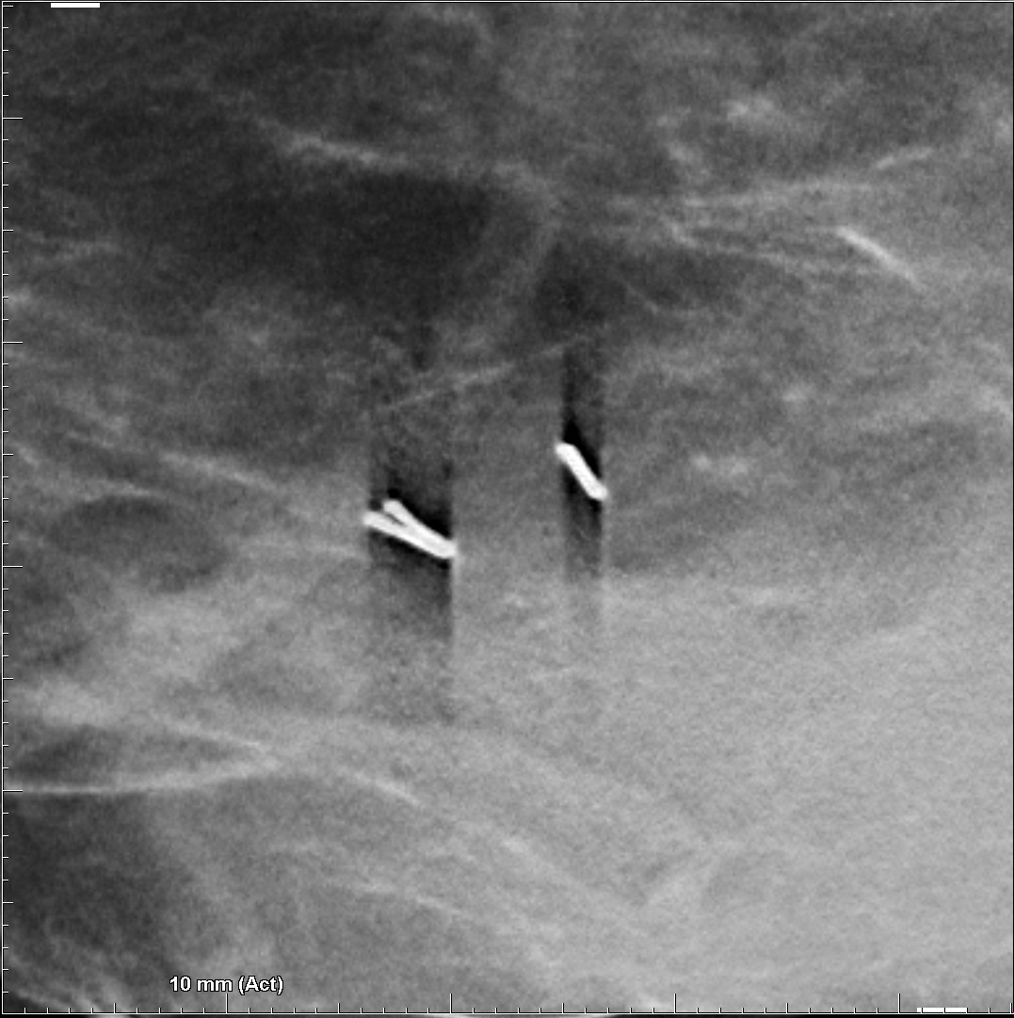
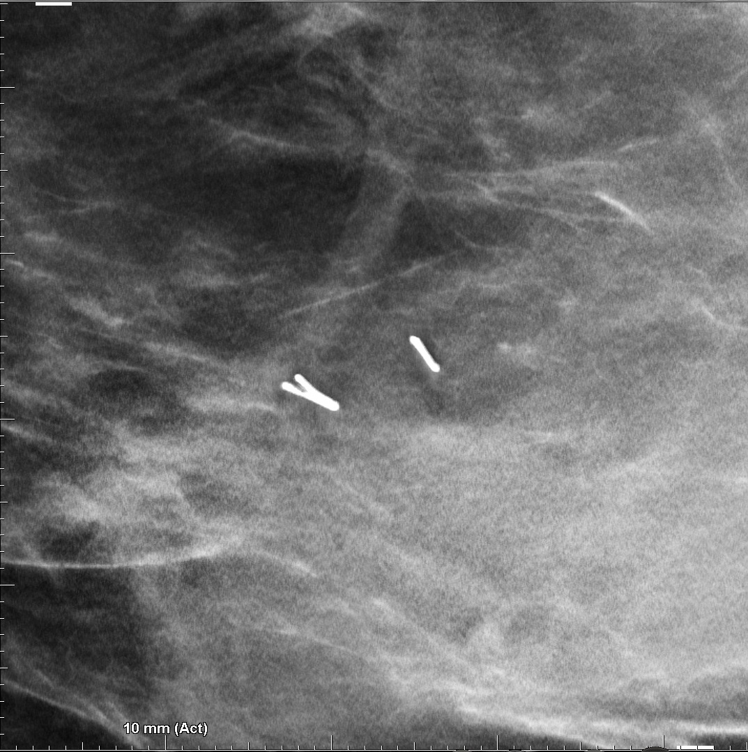
Overall Image Quality: Reduction in Artifacts
C-View™ software
Intelligent 2D™ software
Notes:
This slide shows a region of interest zoomed on location of two surgical clips. The image on left shows the shadow artifacts that are generated on C-View image due to inherent reconstruction artifacts. A novel approach during reconstruction largely eliminates such artifacts, results in a clean appearance of the surgical clip on Intelligent 2D image without any distracting artifacts around the clips.

Slide 37
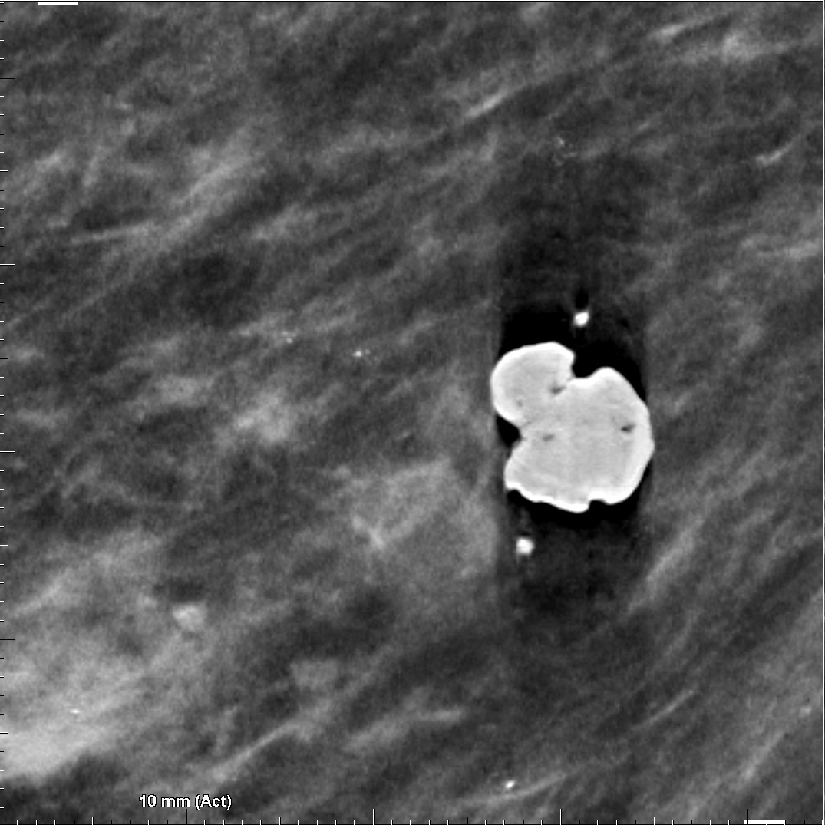
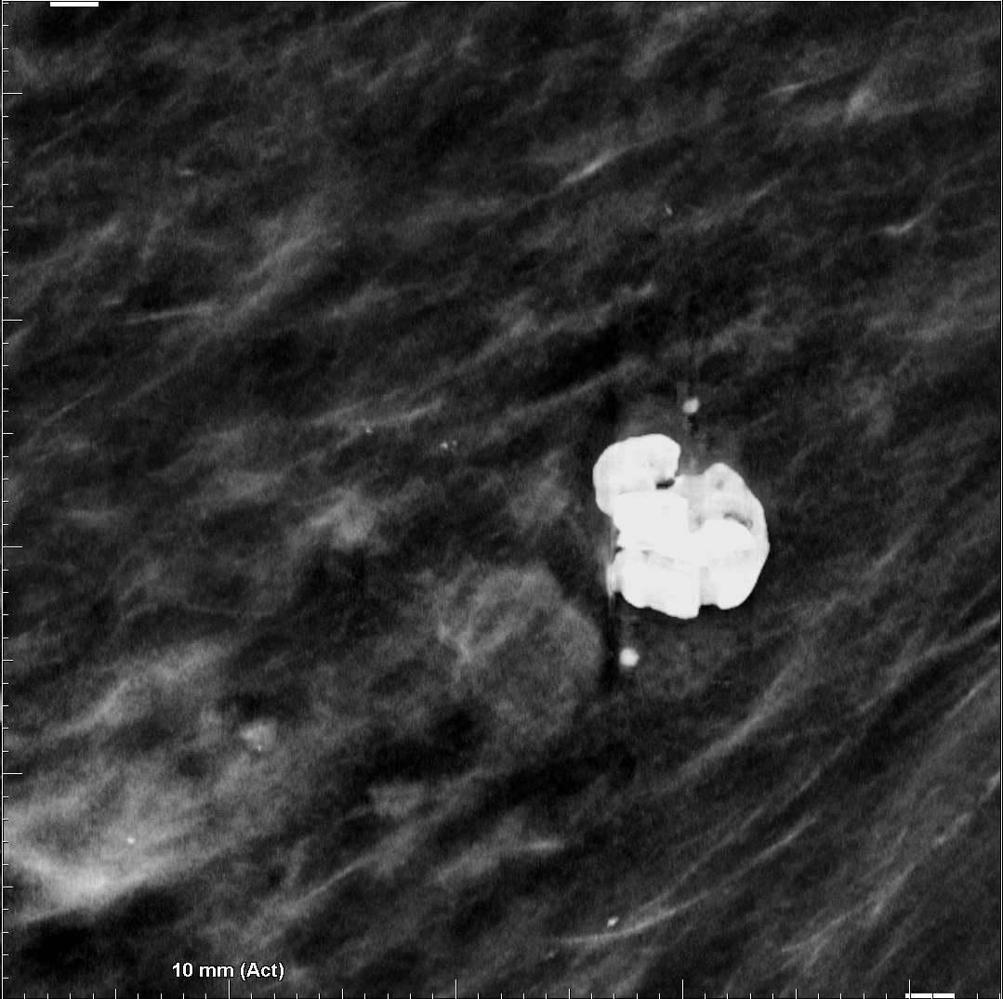
Overall Image Quality: Reduction in Artifacts
C-View™ software
Intelligent 2D™ software
Notes:
This slide illustrate a similar artifact reduction on a pop-corn calcification. The C-View image on the left suffers from a large shadow artifact around the calcification; whereas Intelligent 2D image on the right illustrates reduction in this artifact.

Slide 38
Lesion visibility: Margins, Spiculations and Calcifications
Intelligent 2D™ image is designed to:
Improve visibility of certain subtle spiculated lesions and amorphous calcification clusters
Increase conspicuity on some round and lobulated lesions that may have been partly obscured on C-View™ images
Notes:
Now we will move on to understand improvements in visibility of lesions on Intelligent 2D images. They will have better conspicuity on certain round and lobulated lesions that may have been partly obscured on C-View images. In addition, there will also be improvement in visibility of certain subtle speculated lesions and amorphous calcification clusters.
The advancement in the weighted summation algorithm to accentuate lesions in Intelligent 2D takes advantage of higher resolution information such as high frequency information in margins of masses, fine spiculations and amorphous calcifications.
Let’s review specific examples of images illustrating these advantages.

Slide 39
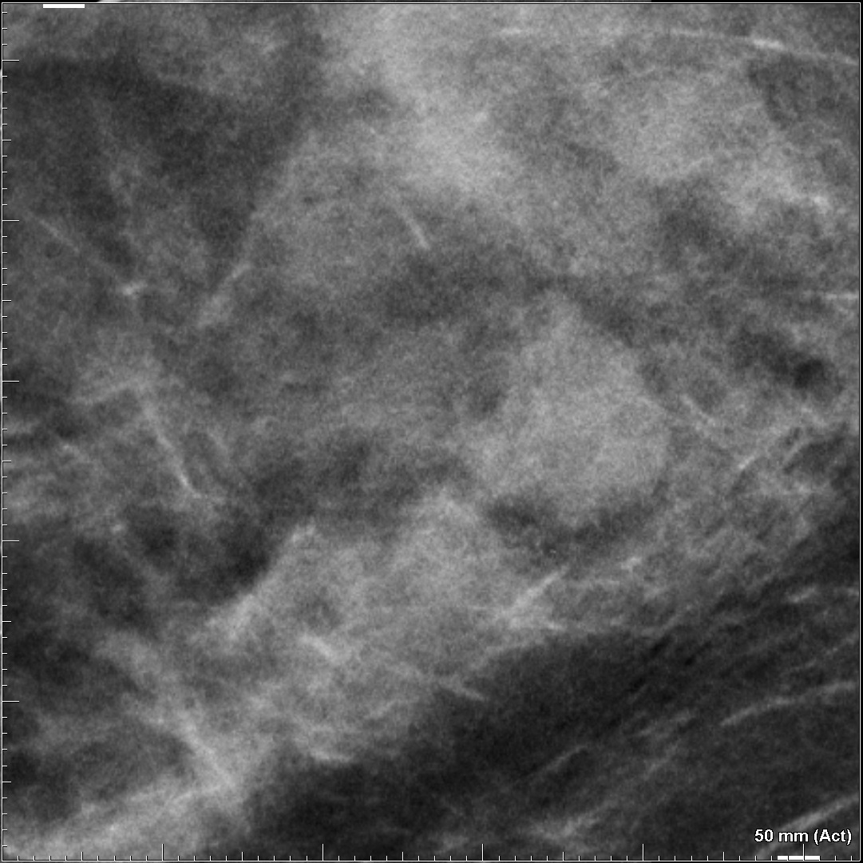
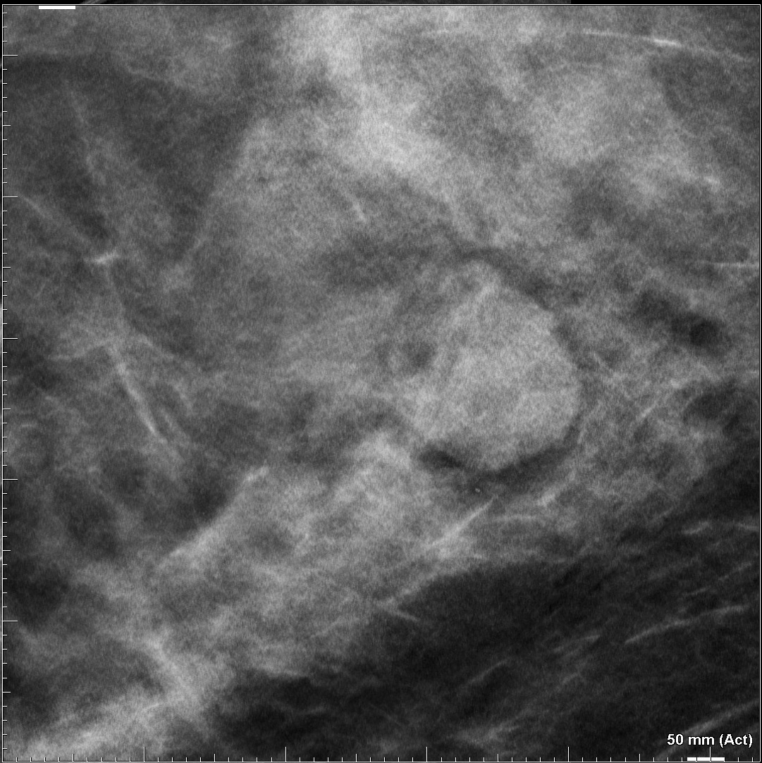
Lesion Visibility: Margins of Round Lesions
C-View™ software
Intelligent 2D™ software
Notes:
This slide illustrates the advantage of Intelligent-2D image in displaying margins of round or lobulated mass lesions. On the left is the region of interest on C-View image showing a mass partially covered by primary dense tissue of the breast. The margins of the mass look ambiguous in C-View image whereas the same region shown on right picture using Intelligent 2D image and the margins of the mass are delineated conspicuously compared with the image on the left.

Slide 40
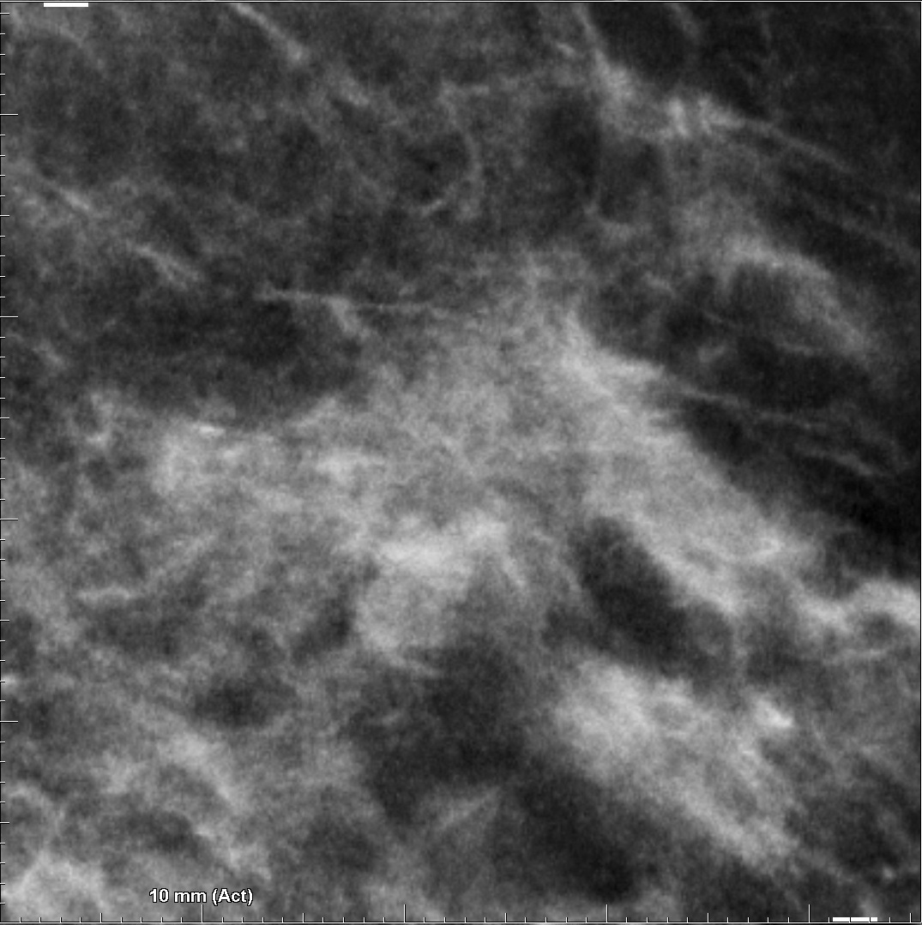
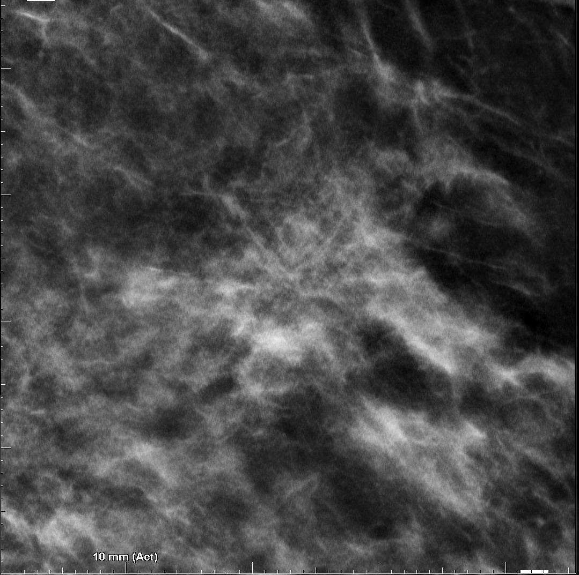
Lesion Visibility: Subtle Spiculations
C-View™ software
Intelligent 2D™ software
Notes:
This slide illustrates the advantage of Intelligent-2D image in displaying a region of subtle architectural distortion. On the left is the region of interest on C-View image showing the lesion whereas on the right is the same lesion on Intelligent 2D image displaying very subtle small spiculation structures that are not visible in C-View image.

Slide 41
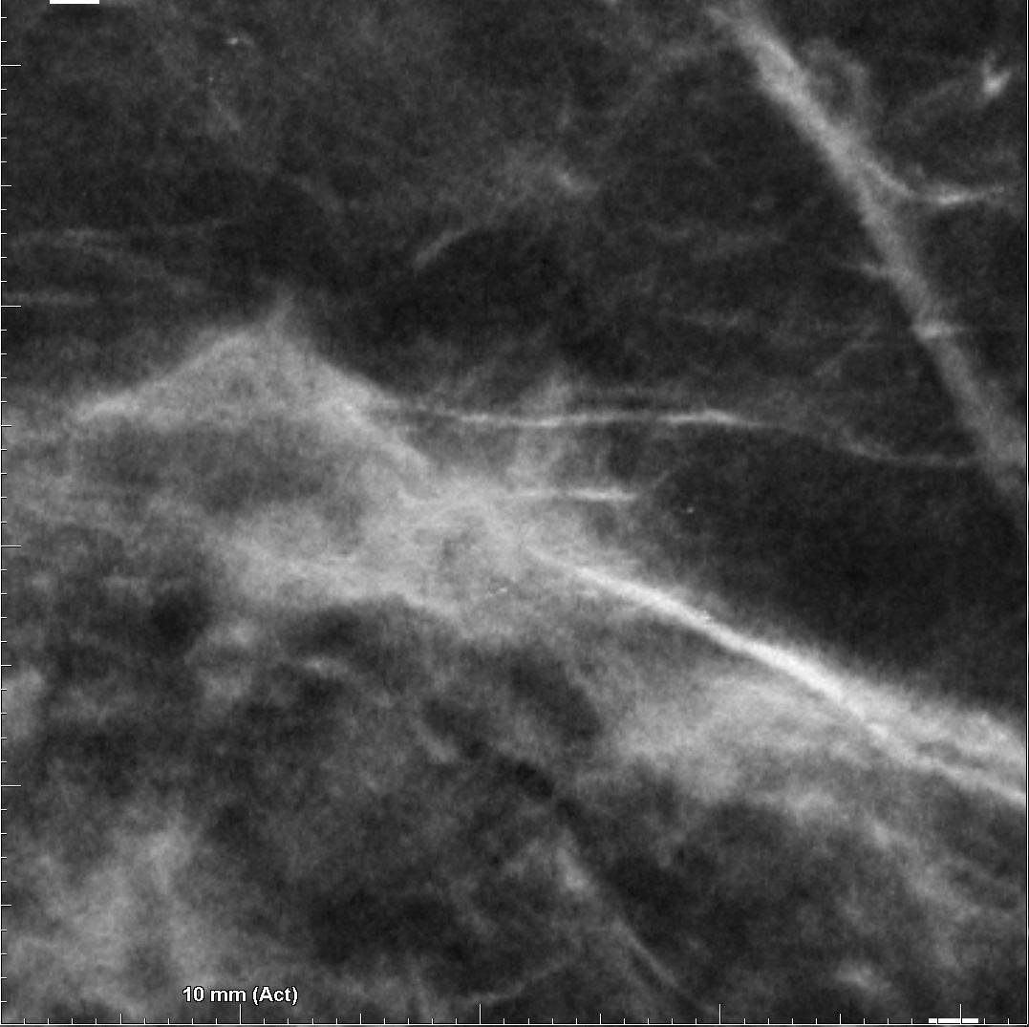
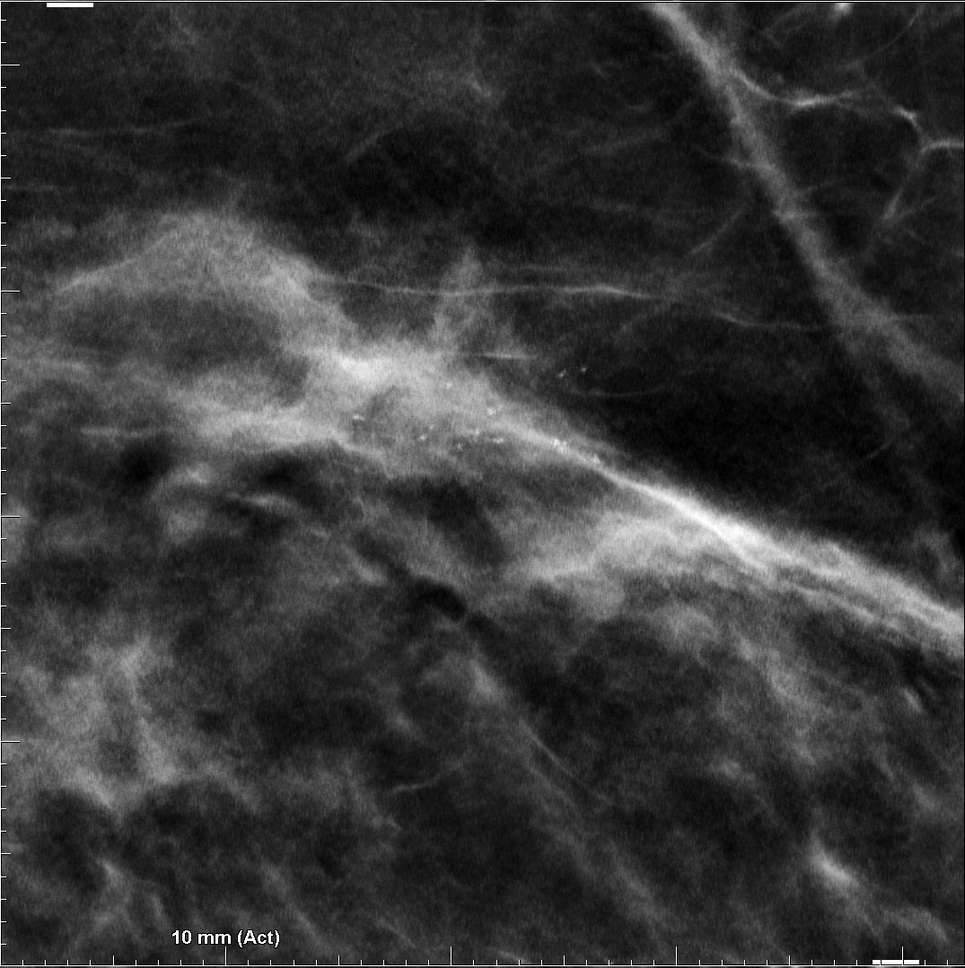
Lesion Visibility: Calcification Cluster
C-View™ software
Intelligent 2D™ software
Notes:
This slide illustrates advantage of Intelligent 2D images for clusters of small calcifications. In this particular example, most elements of the calcification cluster are masked by the density in C-View image; however, the algorithm used to generate Intelligent 2D benefits from high resolution information and can accurately locate and accentuate the calcifications as seen in the image on the right.

Slide 42
Summary: Intelligent 2D™ software Improvements are designed to enhance
Overall image quality
Superior resolution (70μ)
Reduced image noise
Reduced image blur
Improved appearance of skin line
Improvement in overall contrast
Reduction in bright object artifacts
Lesion visibility
Clearer delineation of mass margins
Enhanced spiculations for certain subtle distortions
Improvement in visibility of small micro-calcifications
Notes:
Hologic has been continuously gathering feedback from current users of C-View images and has incorporated enhancements in image quality in response to user’s needs. The improvements in the synthesized 2D algorithm can be characterized into two main categories: (1) enhancements in overall image quality and (2) improvements in visibility of lesions. The improvements in overall image quality are: superior resolution of 70 microns, reduced image noise, reduced image blur, improvement in appearance of skin line, and improvement in overall image contrast.
The improvements in lesion visibility are: Clearer delineation of mass margins – specifically for round and lobulated masses, enhancements in spiculations for certain subtle distortions, and improvements in visibility of tiny micro-calcification clusters
We will begin by reviewing some examples of images that will illustrate overall image quality improvements

Slide 43
Clinical Image Review
Intelligent 2D™ Image Case Review
Notes:
We will begin by reviewing some examples of images that will illustrate overall image quality improvements
Here are a few examples of tomosynthesis studies

Slide 44
Case 1 – Example of artifact reduction
Notes:
Starting with a comparison of Intelligent 2D software and C-View, here’s an example of the artifact reduction.

Slide 45
C-View™
Intelligent 2D™
Significant reduction in artifact from large calcification
Notes:
11…this case demonstrates the reduction in artifact around bright objects with Intelligent 2D…large artifact is distracting,….the smaller calcification artifacts though can be used to detect motion on the tomo set

Slide 46
C-View™
Intelligent 2D™
Notes:
Case 11….C-View on left with significant artifact from very dense, coarse calcification…eliminated on the Intelligent 2D™ image …also note slightly better visualization of axillary nodes

Slide 47
Case 2 – Intelligent 2D™, C-View™, and FFDM differences
Notes:
Now we will review several cases demonstrating differences between Intelligent 2D, C-View and FFDM images.
I will share how Intelligent 2D software has changed the quality of a synthesized image.

Slide 48
FFDM
C-View™
Intelligent 2D™
Notes:
Let‘s start with an example of a normal, fatty breast.
Please take note that the Intelligent 2D™ image, on the far right, has more contrast, better skin line –
…FATTY BREAST..nipple better seen on synthesized images…
case 30

Slide 49
Case 3 – Improved conspicuity of microcalcifications
Notes:
The next case demonstrates the improved conspicuity of microcalcifications

Slide 50
FFDM
C-View™
Intelligent 2D™
Notes:
Case 57 – this case demonstrates improved conspicuity of microcalcifications with Intelligent 2D software.
Let’s take a look at enlargements of these calcifications.

Slide 51
2D
C-View™
Intelligent 2D™
Notes:
Case 57 Calcifications seen better with higher resolution and reduction in noise and blur

Slide 52
Magnification view
Standard tomo slice
High resolution slice
The calcifications are brighter and easier to see on both the tomosynthesis slice and the Clarity HD slice compared to the 2D magnification image
Magnification view still may show more fine calcifications and the entire cluster better than single 1mm slice
Notes:
2D mag view, tomo slice, and high resolution slice
Left click x 2 to demo bullet points

Slide 53
FFDM
C-View™
Intelligent 2D™

Slide 54
Calcifications brighter and sharper with
increased contrast, reduced noise and higher resolution on Intelligent 2D™
Calcifications very faint on FFDM
FFDM
C-View™
Intelligent 2D™
Notes:
Enlargements of previous slide – take note of how faint the microcalcifications are on the FFDM image.
With the Intelligent 2D software, the microcalcifications are brighter, sharper with increased contrast due to reduced noise & high resolution.

Slide 55
Calcifications on magnification view are less bright, but appreciate entire cluster
Calcifications on 1mm slices are brighter and easier to see but entire cluster is not on one slice
Magnification view
Standard tomo slice
High resolution slice
Notes:
High resolution slice a bit sharper, calcifications easier to see. Both better than mag view

Slide 56
Case 4 – Microcalcifications in Dense Breast Tissue

Slide 57
FFDM
C-View™
Intelligent 2D™
Notes:
With very dense breasts, the differences may not be as obvious, though skin line is definitely more defined on Intelligent 2D™ image…next slide shows calcifications, same case but magnified

Slide 58
FFDM
C-View™
Intelligent 2D™
Notes:
80……calcifications are sharper on the C-View image and even sharper on I2D…reduced noise would mean fewer pseudo-calcifications and crisper calcification delineation

Slide 59
Case 5 – Architectural distortion with mildly dense breast tissue
Notes:
These next few cases will speak to the improvement of identifying architectural distortions

Slide 60
Case 103
FFDM
C-View™
Intelligent 2D™
Notes:
Case 103..mildly dense breast, with architectural distortion lateral left breast….again, better skin line, distortion sharper, greater contrast

Slide 61
Architectural distortion sharper, better skin line, less noise, higher contrast with Intelligent 2D™
FFDM
C-View™
Intelligent 2D™
Notes:
Case 103…these are just zoomed in to show better detail, both C view and I2D have better margin detail, and I2D has increased contrast
Click x 4 to display arrows & text

Slide 62
FFDM
C-View™
Intelligent 2D™
Notes:
Note difference in axillary detail, spiculated mass in UOQ, skin line, contrast

Slide 63
Spiculations are sharper, better contrast, and less noise with Intelligent 2D™
FFDM
C-View™
Intelligent 2D™
Notes:
These are enlargements of the previous images: Note difference in axillary detail, spiculated mass in UOQ, skin line, contrast
Spiculations are sharper, better contrast, and less noise with Intelligent 2D™

Slide 64
Case 6 – Architectural distortion with mildly dense breast tissue
Notes:
This next case demonstrates the ability of Intelligent 2D software to increase resolution and contrast.
Heterogeneous calcifications

Slide 65
FFDM
C-View™
Intelligent 2D™
Notes:
Case 63 CC view – lateral portion of the right breast
Distortion is seen

Slide 66
Spiculated mass seen on FFDM
Mass/spiculations enhanced with C-View™
Intelligent 2D™ provides increased sharpness and contrast
FFDM
C-View™
Intelligent 2D™
Notes:
Case 63 note the differences between the 3 enlargements

Slide 67
FFDM
C-View™
Intelligent 2D™
Notes:
MLO views demonstrating the AD in the right breast
Next slide is the enlargements

Slide 68
FFDM
C-View™
Intelligent 2D™
Fine detail seen best with decreased blur and noise, increased contrast
Notes:
The Intelligent 2D software decreases blur & noise but increases image contrast

Slide 69
Case 7 – Subtle UOQ architectural distortion
Notes:
This next case demonstrates the ability of Intelligent 2D software to increase resolution and contrast.

Slide 70
FFDM
C-View™
Intelligent 2D™
Notes:
Case 115 -Subtle UOQ distortion

Slide 71
FFDM
C-View™
Intelligent 2D™
Distortion is much sharper with higher resolution and decreased noise and blur
Notes:
Case 115 left click x 2

Slide 72
FFDM
C-View™
Intelligent 2D™
Notes:
MLO views - AD – let’s look at the enlargements

Slide 73
Distortion is much more vague on MLO views
Visualization a bit better, though subtle, with increased resolution and contrast
FFDM
C-View™
Intelligent 2D™

Slide 74
Case 8 – Increase conspicuity of smooth masses

Slide 75
FFDM
C-View™
Intelligent 2D™
Notes:
Case 68 This case demonstrates a smooth mass
smooth mass is better seen on I2D, also sharper skin line, higher contrast

Slide 76
Intelligent 2D™ demonstrates sharper margin delineation compared to C-View™
FFDM
C-View™
Intelligent 2D™
Notes:
Case 68 smooth masses….with intelligent 2D, some smooth masses will have a sharper margin…also less noise

Slide 77
Case 9 – Sharpness of axilla

Slide 78
FFDM
C-View™
Intelligent 2D™
Notes:
Case 77…calcs and sharpness of axilla

Slide 79
FFDM
C-View™
Intelligent 2D™
With C-View™, sometimes the axillary contents not clearly defined
With Intelligent 2D™, there is increased contrast and sharpness of axillary contents
Notes:
Case 77…now let’s look at the sharpness of axilla….on C-View, detail in axilla lost…with Intelligent 2D, gain more detail and sharpness in axilla

Slide 80
Case 10 – Increased resolution and contrast
Notes:
This next case demonstrates the ability of Intelligent 2D software to increase resolution and contrast.
Heterogeneous calcifications

Slide 81
Grouping of malignant calcifications left UOQ
FFDM
C-View™
Intelligent 2D™
Notes:
Case 31 malignant calcifications in this left breast
Let’s take a closer look

Slide 82
Very hard to appreciate the calcifications on FFDM
Heterogeneous calcifications best seen on Intelligent 2D™ with increased resolution and contrast
FFDM
C-View™
Intelligent 2D™
Notes:
Case 31 malignant calcifications left

Slide 83
Intelligent 2D™ provides a much clearer image of the axilla/nodes
FFDM
C-View™
Intelligent 2D™
Notes:
Axillary detail becomes much sharper

Slide 84
Intelligent 2D™ software: Improvements over C-View™ software are designed to enhance
Overall image quality
Superior resolution (70μ)
Reduced image noise
Reduced image blur
Improved appearance of skin line
Improvement in overall contrast
Reduction in bright object artifacts
Lesion visibility
Clearer delineation of mass margins
Enhanced spiculations for certain subtle distortions
Improvement in visibility of small micro-calcifications
Notes:
Hologic has been continuously gathering feedback from current users of C-View images and has incorporated enhancements in image quality in response to user’s needs. The improvements in the synthesized 2D algorithm can be characterized into two main categories: (1) enhancements in overall image quality and (2) improvements in visibility of lesions. The improvements in overall image quality are: superior resolution of 70 microns, reduced image noise, reduced image blur, improvement in appearance of skin line, and improvement in overall image contrast.
The improvements in lesion visibility are: Clearer delineation of mass margins – specifically for round and lobulated masses, enhancements in spiculations for certain subtle distortions, and improvements in visibility of tiny micro-calcification clusters
We will begin by reviewing some examples of images that will illustrate overall image quality improvements

Slide 85
Clarity HD / Intelligent 2D™ Takeaway Messages
Clarity HD is higher resolution than Hologic Standard Tomo
Intelligent 2D™ takes advantage of the high resolution of Clarity HD™
The improvement in image quality with the higher resolution tomo and synthesized 2D can be demonstrated

Slide 86
Additional publication information
Data on file and from public sources, 2017
FDA PMA submission P080003/S001.
Rafferty EA, Park JM, Philpotts LE, Poplack SP, Sumkin JH, Halpern EF, Niklason LT. Assessing radiologist performance using combined digital mammography and breast tomosynthesis compared with digital mammography alone: results of a multicenter, multireader trial. Radiology. 2013 Jan;266(1):104-13. doi: 10.1148/radiol.12120674. Epub 2012 Nov 20
Skaane P, Bandos AI, Eben EB, Jebsen IN, Krager M, Haakenaasen U, Ekseth U, Izadi M, Hofvind S, Gullien R. Two-View Digital Breast Tomosynthesis Screening with Synthetically Reconstructed Projection Images: Comparison with Digital Breast Tomosynthesis with Full-Field Digital Mammographic Images. Radiology. 2014 Jan 24:131391.

